Slide 1
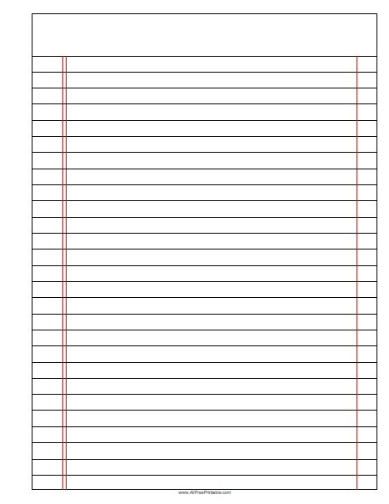






Feedback Lesson
Read Now
Sunday, 18 January 2026
Feedback Lesson
Task:
Complete the Read Now by:
Stick in the sheet.
Using a highlighter as you read to identify key terms.
Answer the first four recall questions under the sheet in your book.
Answer the stretch question
Feedback Lesson
Feedback Lesson
Aim High | Work Together | Be Kind | Lead the Way

Slide 2
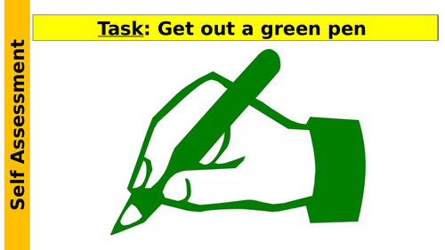
Read Now
Aim High | Work Together | Be Kind | Lead the Way
Aim High | Work Together | Be Kind | Lead the Way

Slide 3
Read Now
MARK SCHEME
1. Interdependence is when organisms depend on each other for survival. (line 1)
2. Plants make food and give off oxygen; animals breathe in oxygen and produce carbon dioxide. (lines 2-3)
3. An example of interdependence is bees and flowers. (line 5)
4. Bees collect nectar from flowers. (line 6)
5. Interdependence is important because it helps organisms survive. (line 7)
Aim High | Work Together | Be Kind | Lead the Way
Aim High | Work Together | Be Kind | Lead the Way

Slide 4
Daily Review
Follow your teachers instructions:
“When I say go show me a MWB and a MWB Pen”
You will have 10 seconds for each question.
Hold your MWB in the Ready position
“Show me”
You need to score 70% to pass
Subtitle ‘test score’ ?/10
Aim High | Work Together | Be Kind | Lead the Way
Notes:
Teachers remember to input the quiz score

Slide 5
MWB Quiz
What is the name of an organism that eats other organisms?
What is used to increase the yield of a farmer’s field?
What is the term for an extreme food shortage?
What is the term for having enough food to feed a population?
What is the process of minerals moving through the soil due to rain fall?

Slide 6
MWB Quiz
What is the name of an organism that eats other organisms? Predator
What is used to increase the yield of a farmer’s field? Fertiliser
What is the term for an extreme food shortage? Famine
What is the term for having enough food to feed a population? Food security
What is the process of minerals moving through the soil due to rain fall? Leaching

Slide 7
Objectives
Following this lesson, students will be able to:
• State…
• Describe…
• Explain…
Lesson 1
Lesson 2
Lesson 3
Lesson 4
Lesson 5
Lesson 6
Lesson 8
Lesson 9
Lesson 10
Lesson 7
Aim High | Work Together | Be Kind | Lead the Way
Notes:
11.2 5.19

Slide 8
Exposition
Aim High | Work Together | Be Kind | Lead the Way
Notes:
11.31 1.42
11.2 4.35

Slide 9
Exposition
Aim High | Work Together | Be Kind | Lead the Way
Notes:
11.31 1.42
11.2 4.35

Slide 10
Exposition
Aim High | Work Together | Be Kind | Lead the Way
Notes:
11.2 1.43
11.2 1.7

Slide 11
Deliberate Practice
Big Question:
Aim High | Work Together | Be Kind | Lead the Way

Slide 12
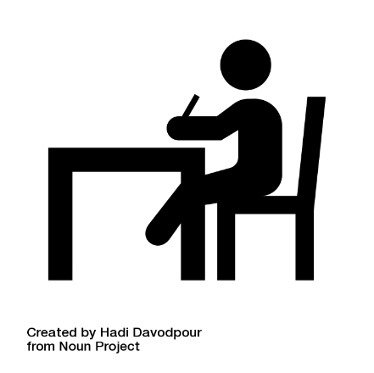
Deliberate Practice
Aim High | Work Together | Be Kind | Lead the Way

Slide 13
Exit Ticket
B. More humans are growing bigger so need more food, causing food shortages
Aim High | Work Together | Be Kind | Lead the Way

